Slide 1


Tinder Trails No Sparks allowed
Chris Hernandez, Claudia Caceres
Joe Gorfinkle, Wan-Fang Chou
IST 303 Software Development
February 11, 2019

Slide 2
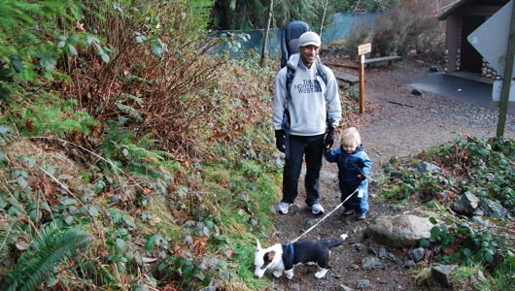
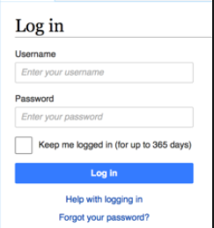

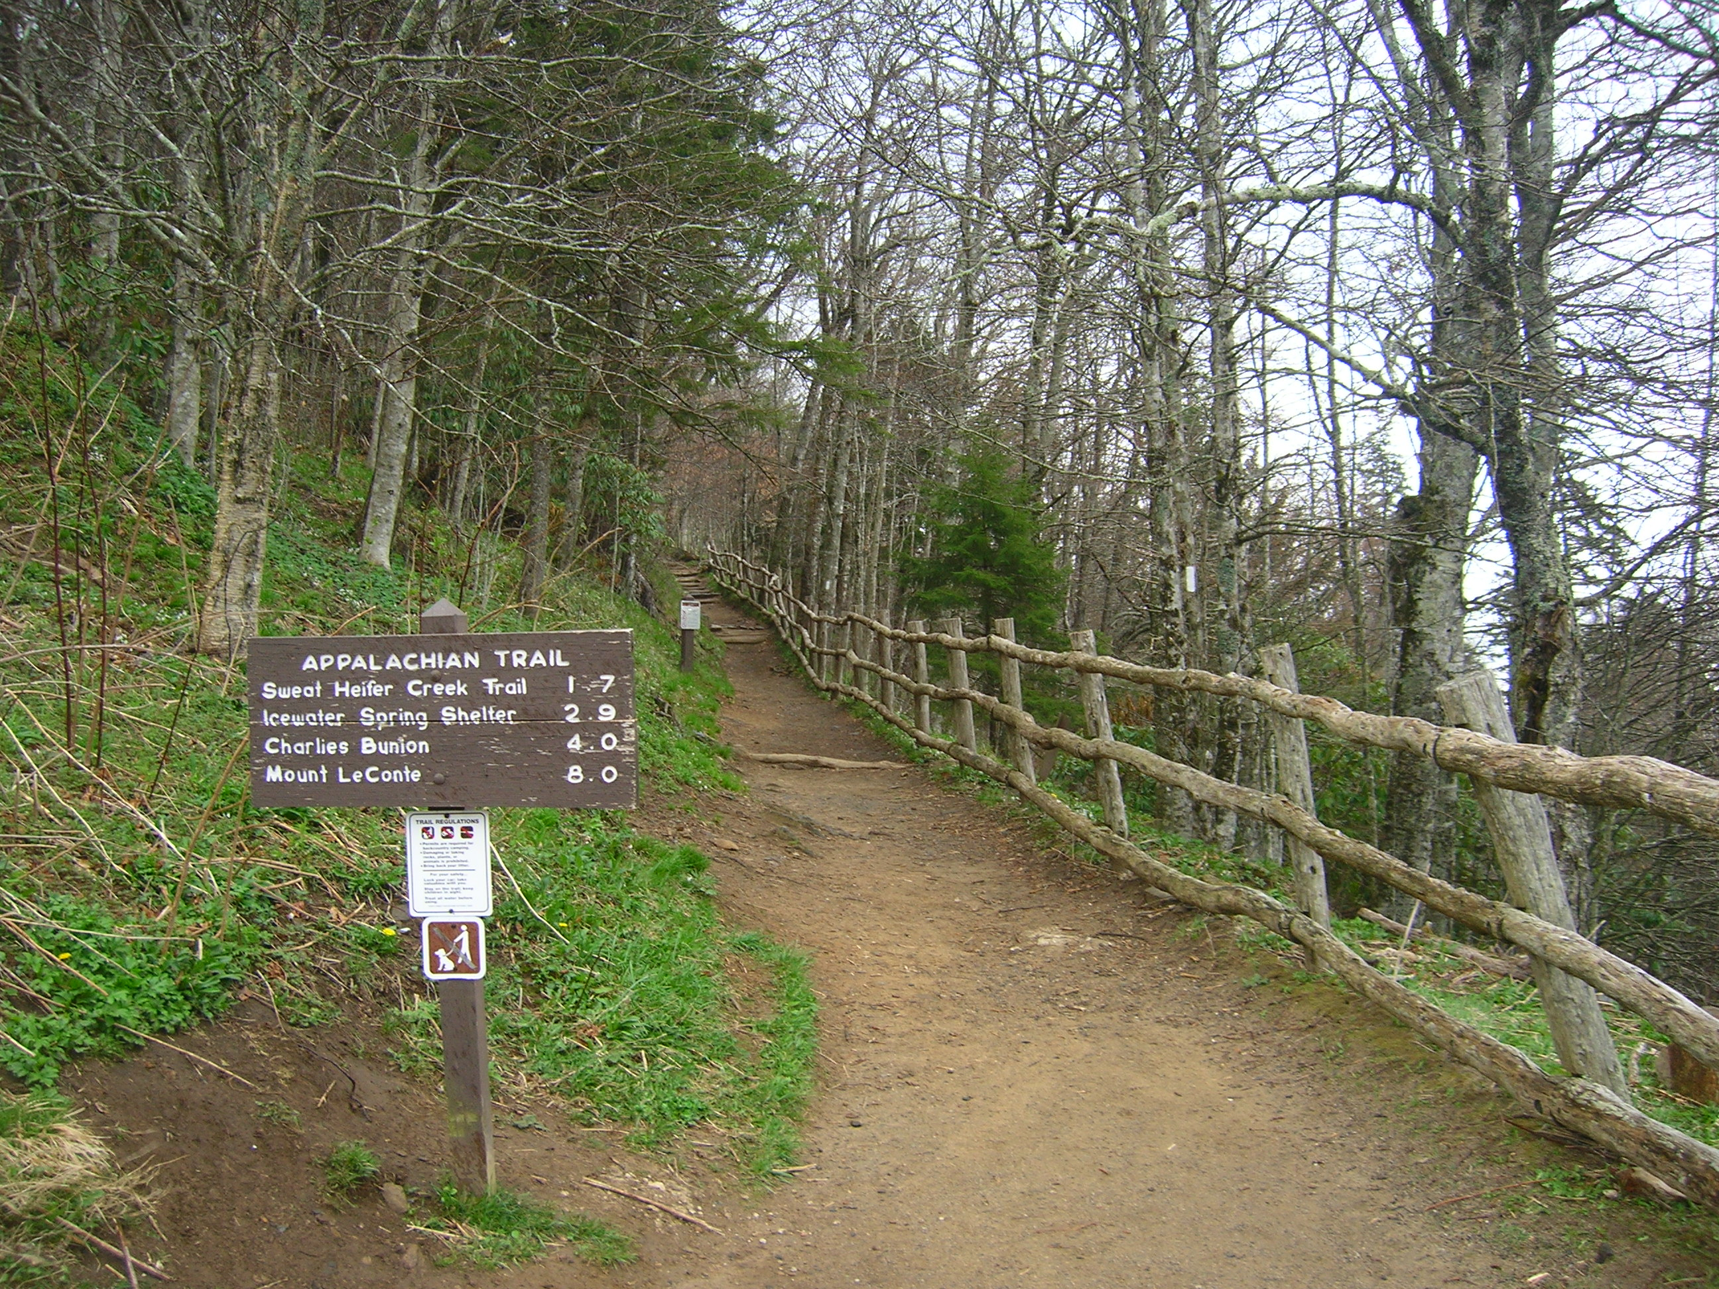
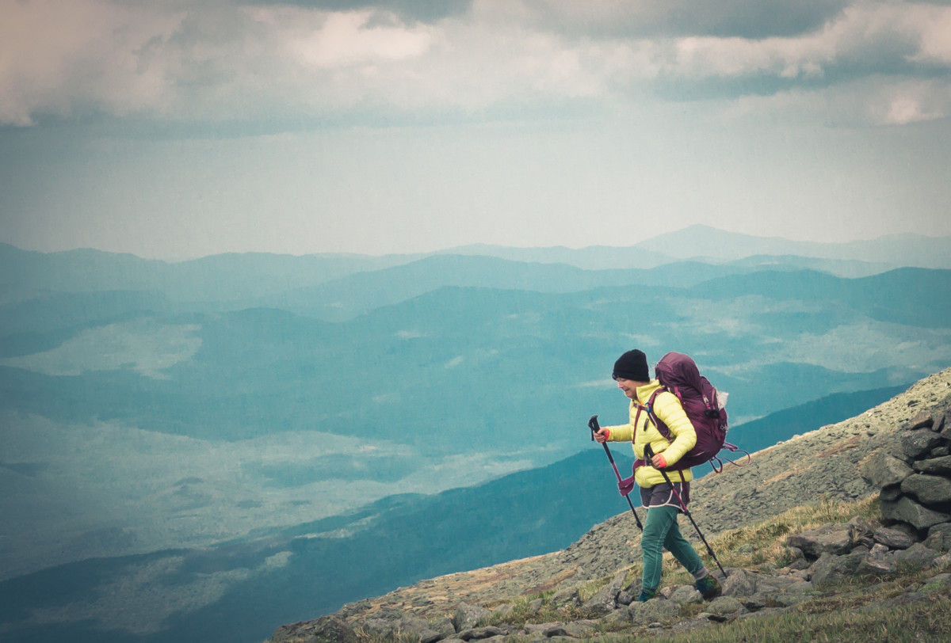


MAIN PAGE
User selects
1 of 4
Child/Dog Friendly
Nearby
Your Spec
Equipment

Slide 3
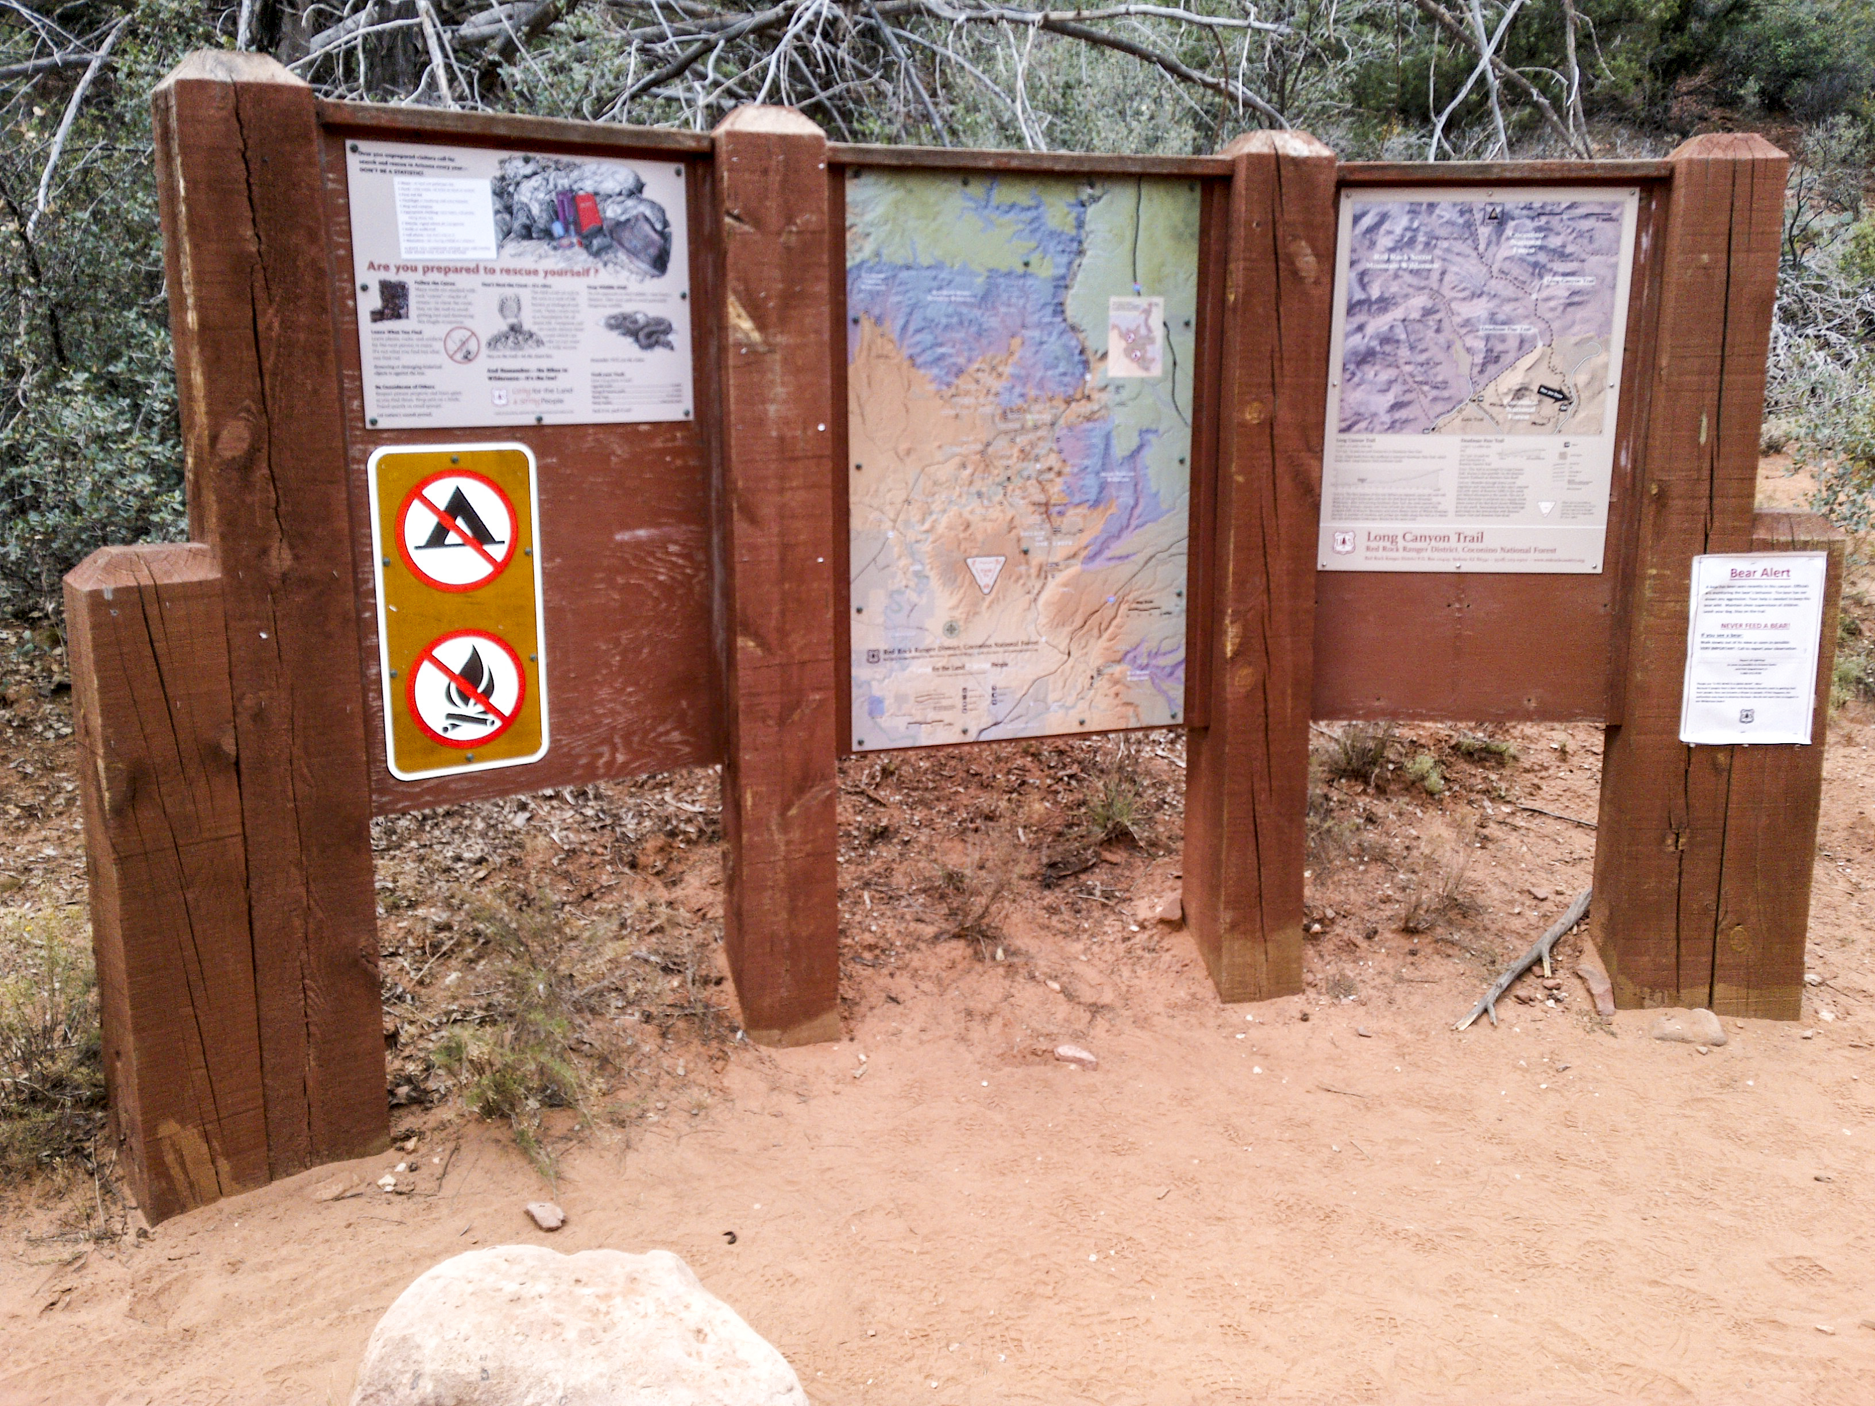
TRAIL INFORMATION PAGE
TRAIL NAME
- length (meters, miles)
- difficulty (easy, moderate, difficult)
- average slope
- total elevation rise
- peak elevation
- estimated round trip time
- reviews/ratings
- mountain bikes / motorized vehicles prohibited

Slide 4









TRAIL AMENITY PAGE

Slide 5






DEVELOPMENT
ENVIRONMENT

Slide 6
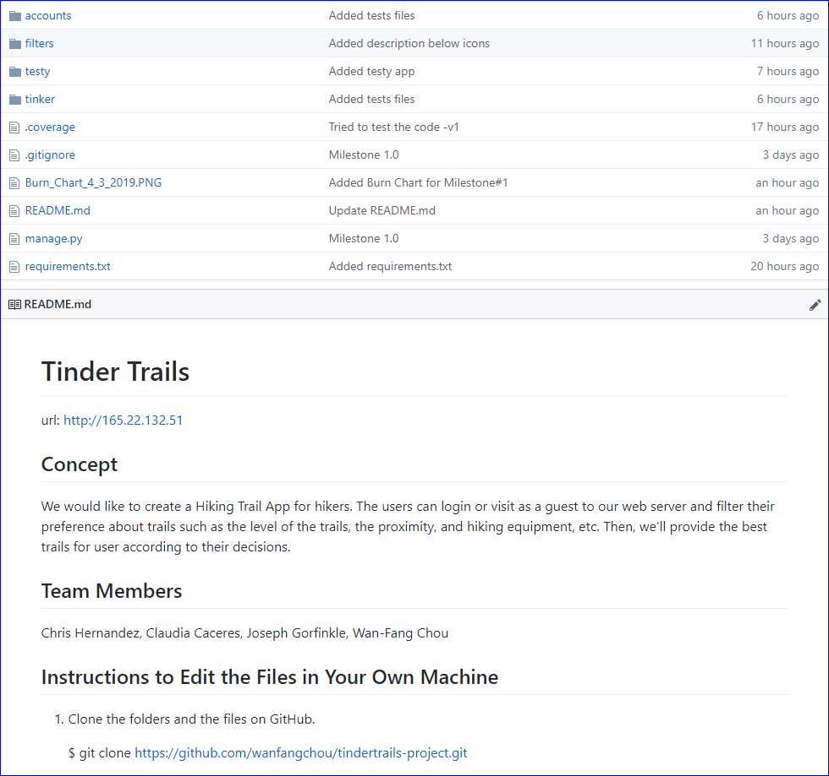
GitHub

Slide 7
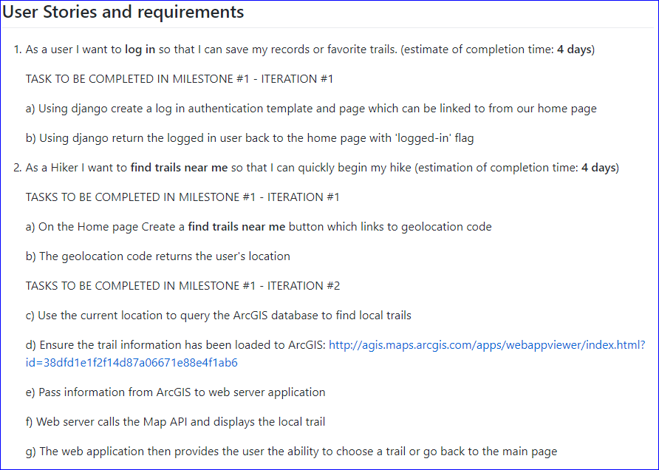
Milestone #1 – 2 user stories, 10 tasks

Slide 8
Demo Django Login & ArcGIS connector & code walk through
http://165.22.132.51/
Demo Hiking Trail Features & code walk through

Slide 9
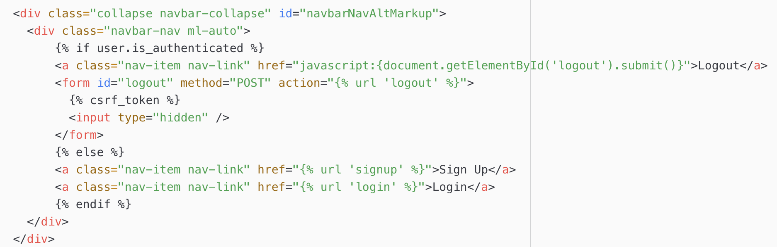
Django code walk through US_1a_Using Django to create sign up, login and log out
(tindertrails-project/tinker/templates/base.html)
Navigation bar

Slide 10
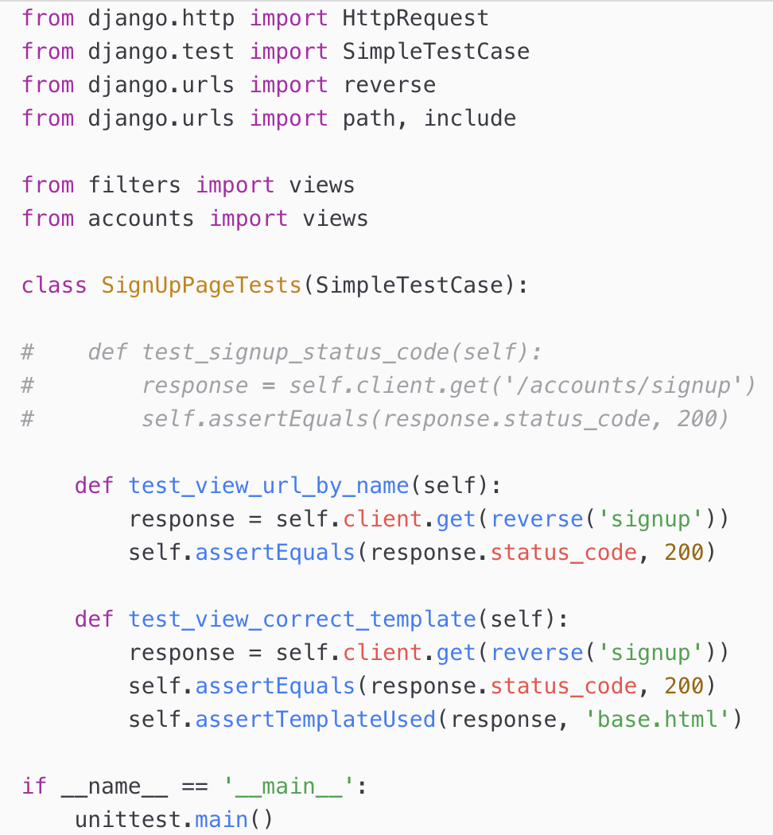
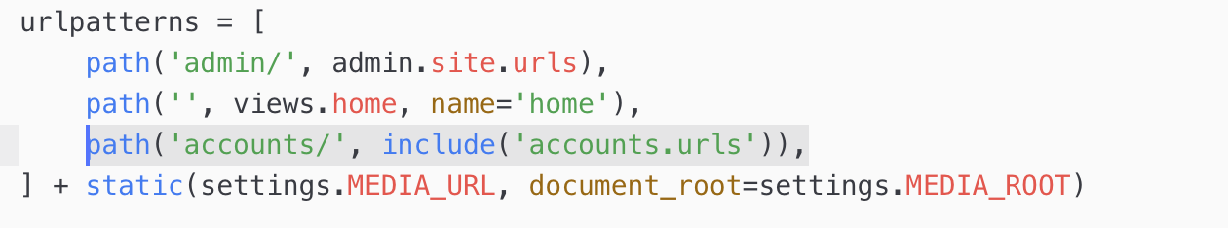
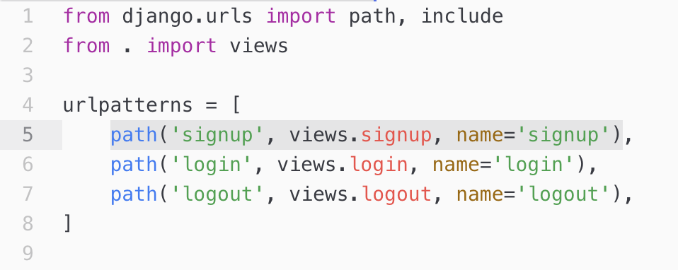
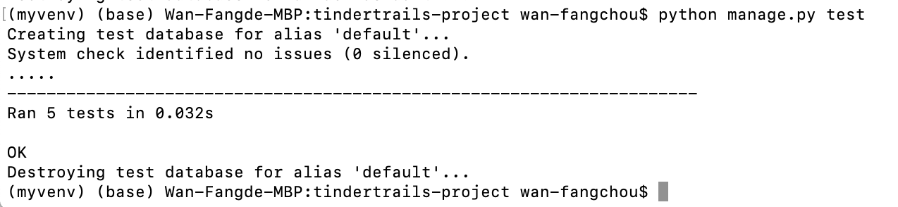
Django code walk through and test US_1a_Using Django to create sign up, login and log out
Test
Sign Up
Sign Up url: http://165.22.132.51/accounts/signup
(tindertrails-project/tinker/urls.py)
(tindertrails-project/accounts/urls.py)

Slide 11
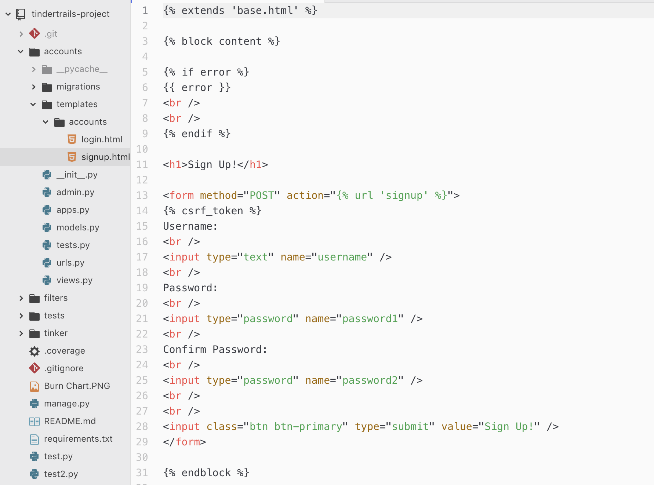
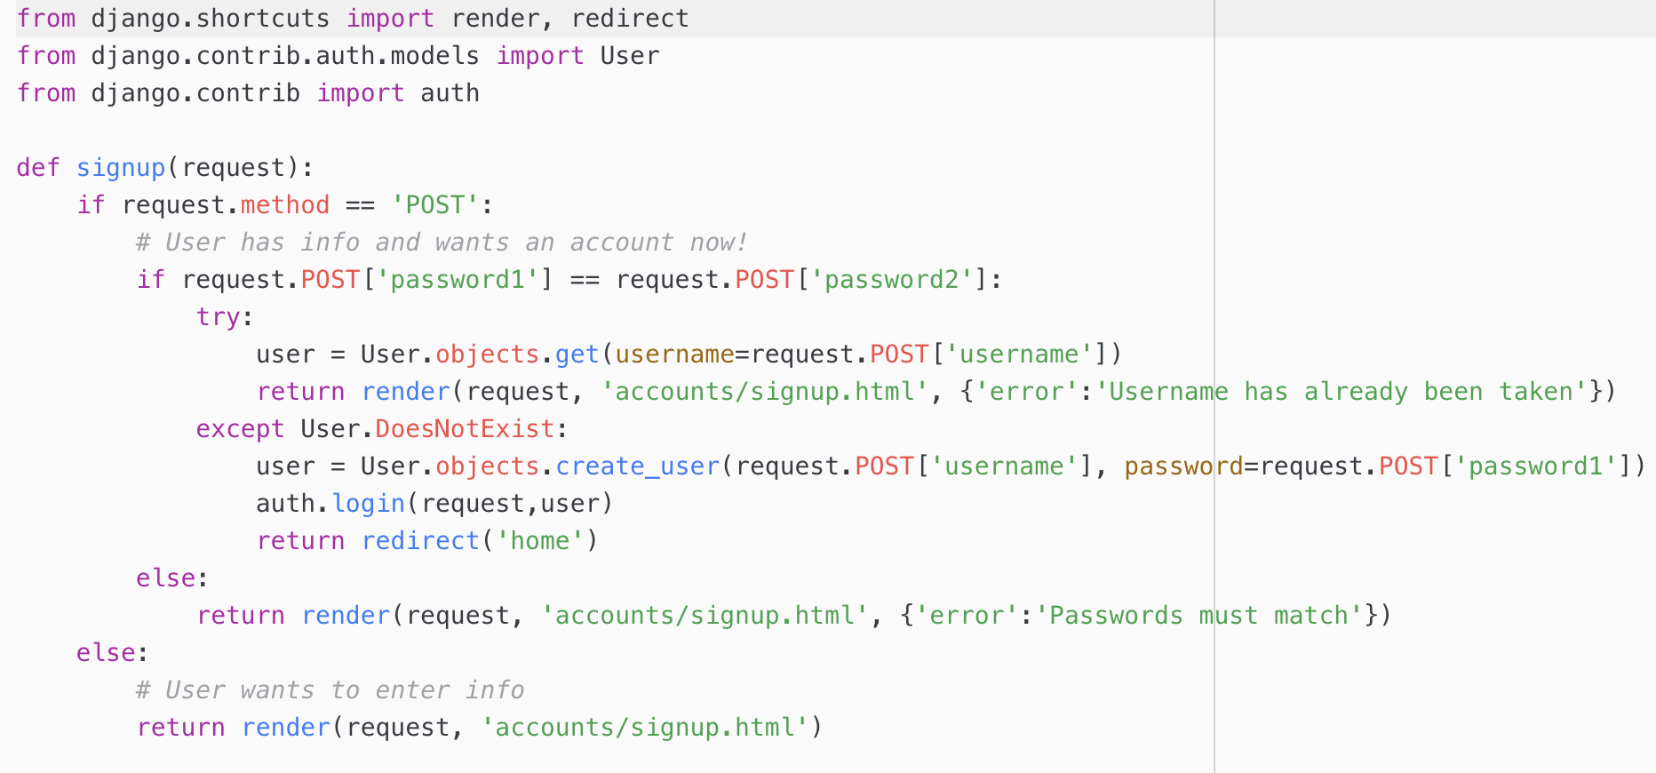
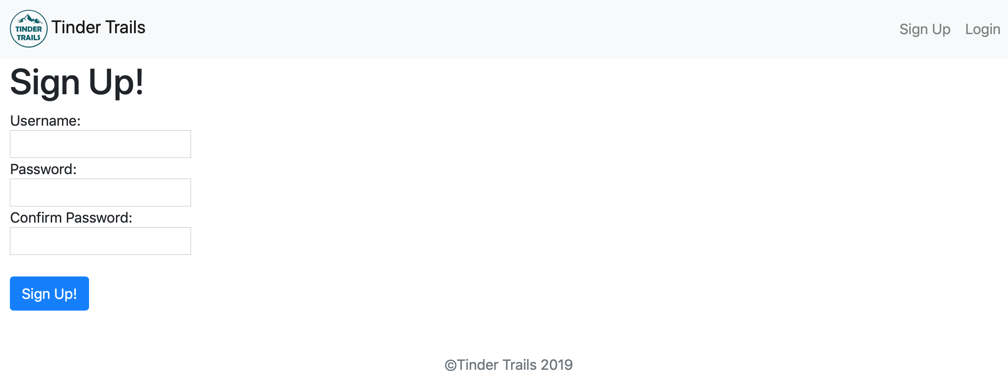
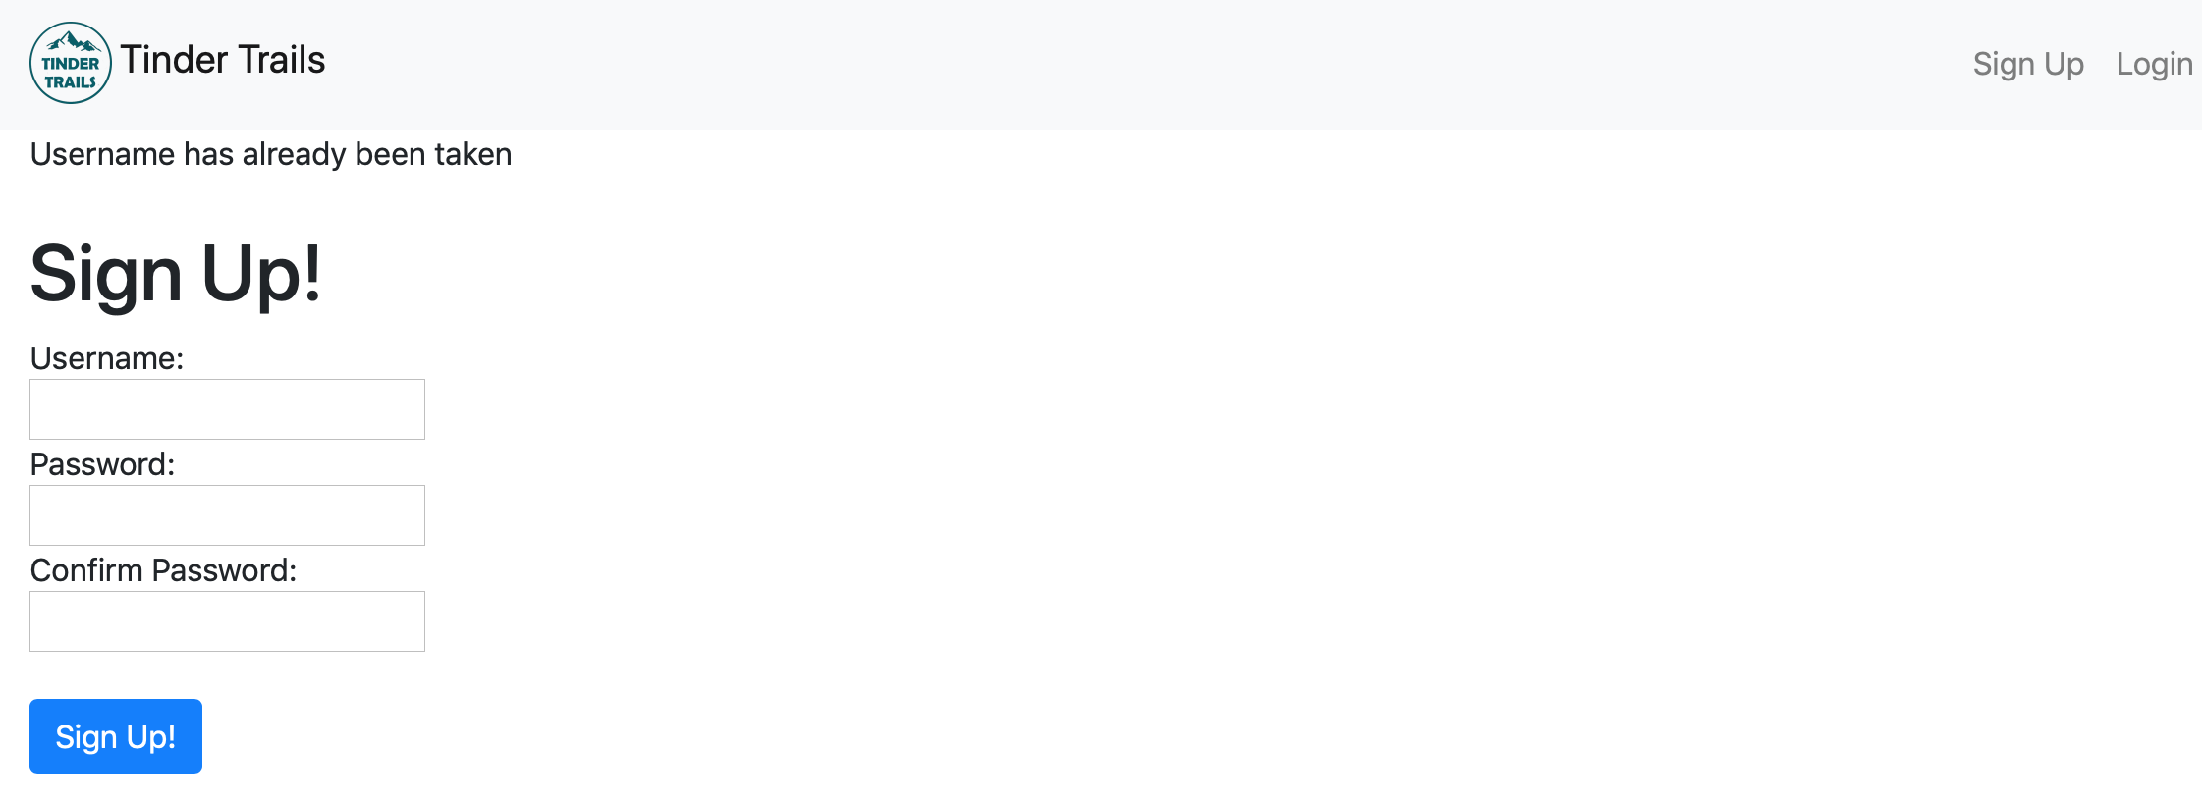
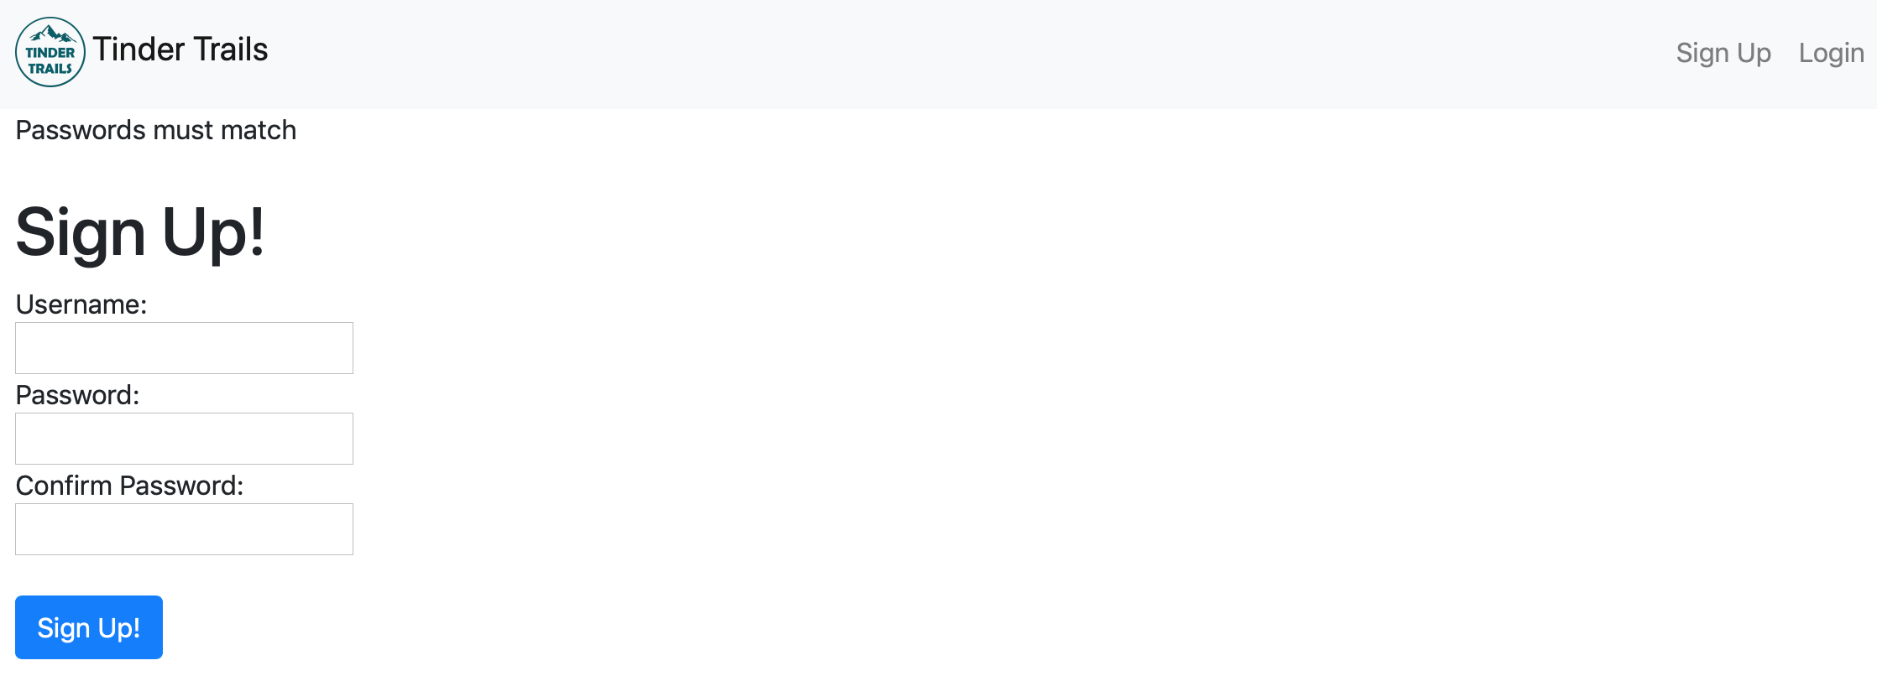
Django code walk through US_1a_Using Django to create sign up, login and log out
Sign Up
(accounts/templates/accounts/signup.html)
(tindertrails-project/accounts/views.py)

Slide 12
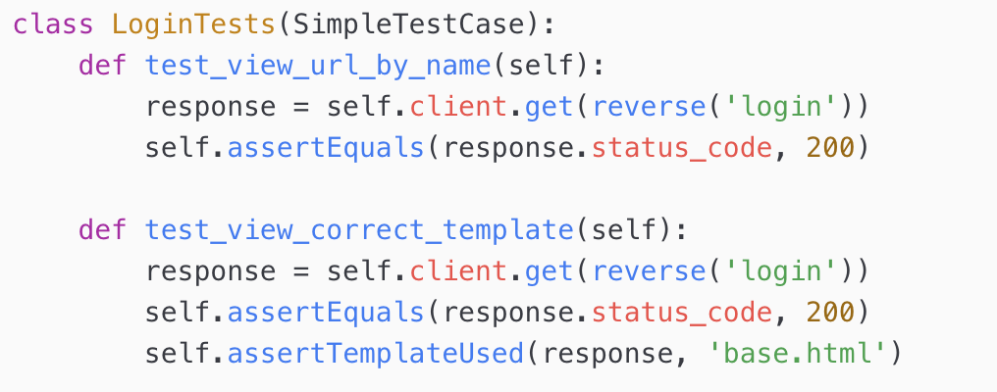
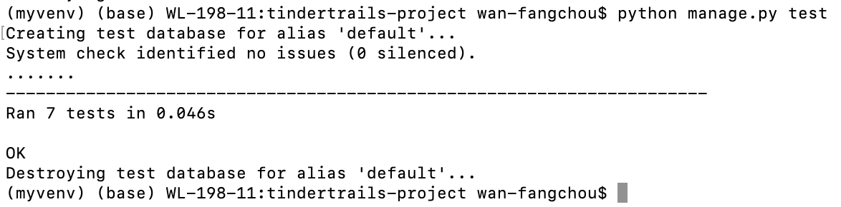
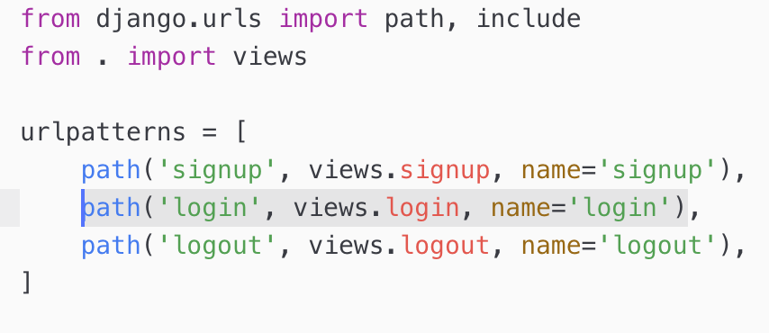
Django code walk through and test US_1a_Using Django to create sign up, login and log out US_1b_Send users back once they logged in or log out
Login
Test
Login url: http://165.22.132.51/accounts/login
(tindertrails-project/tinker/urls.py)
(tindertrails-project/accounts/urls.py)

Slide 13
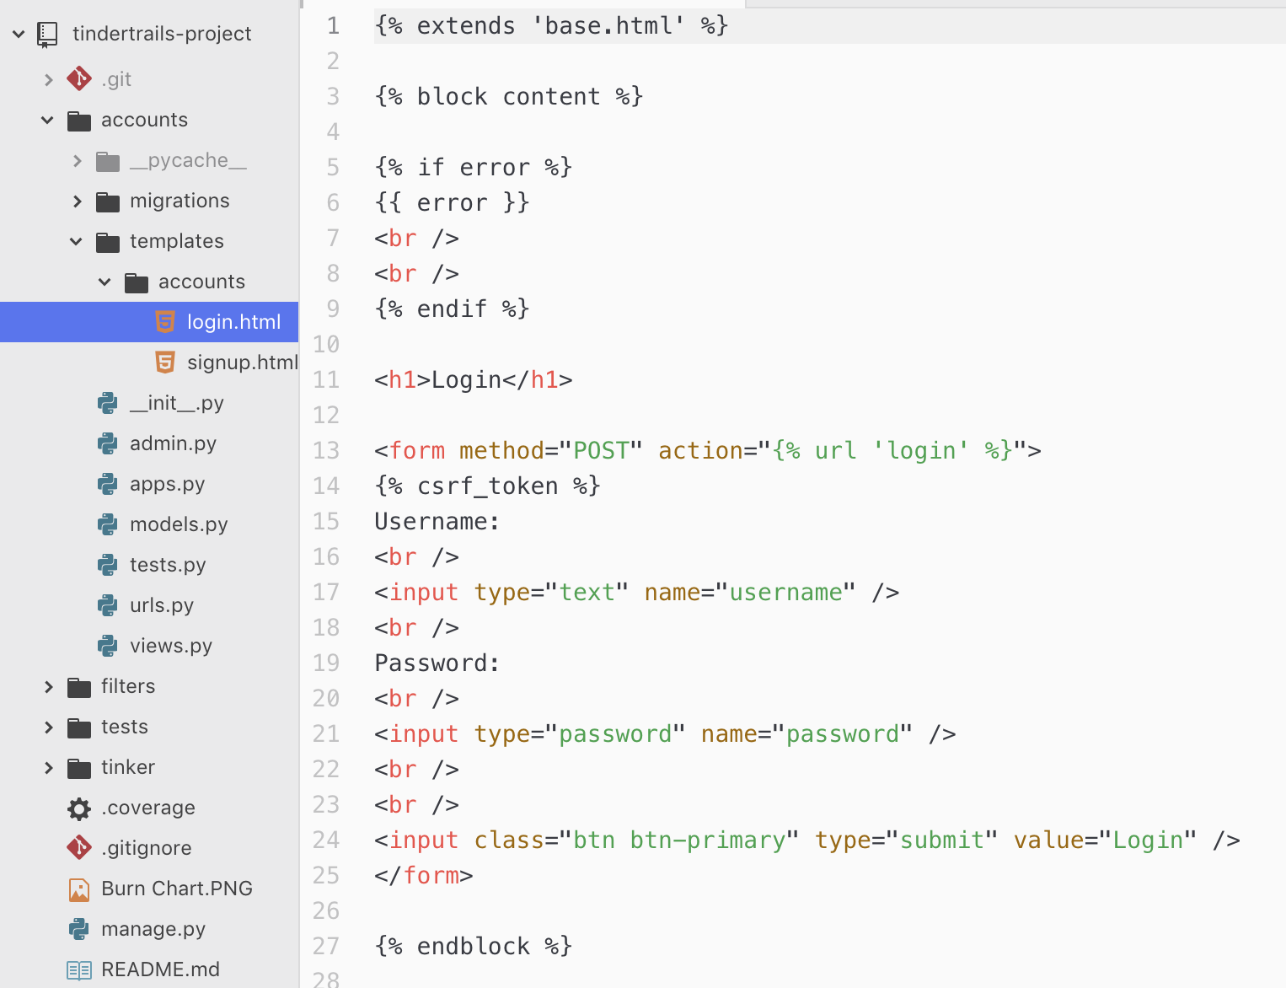
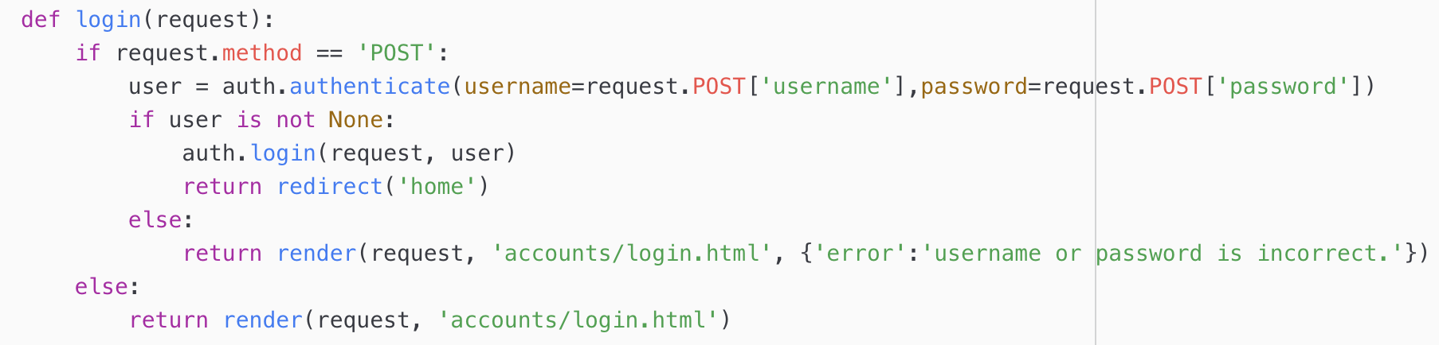
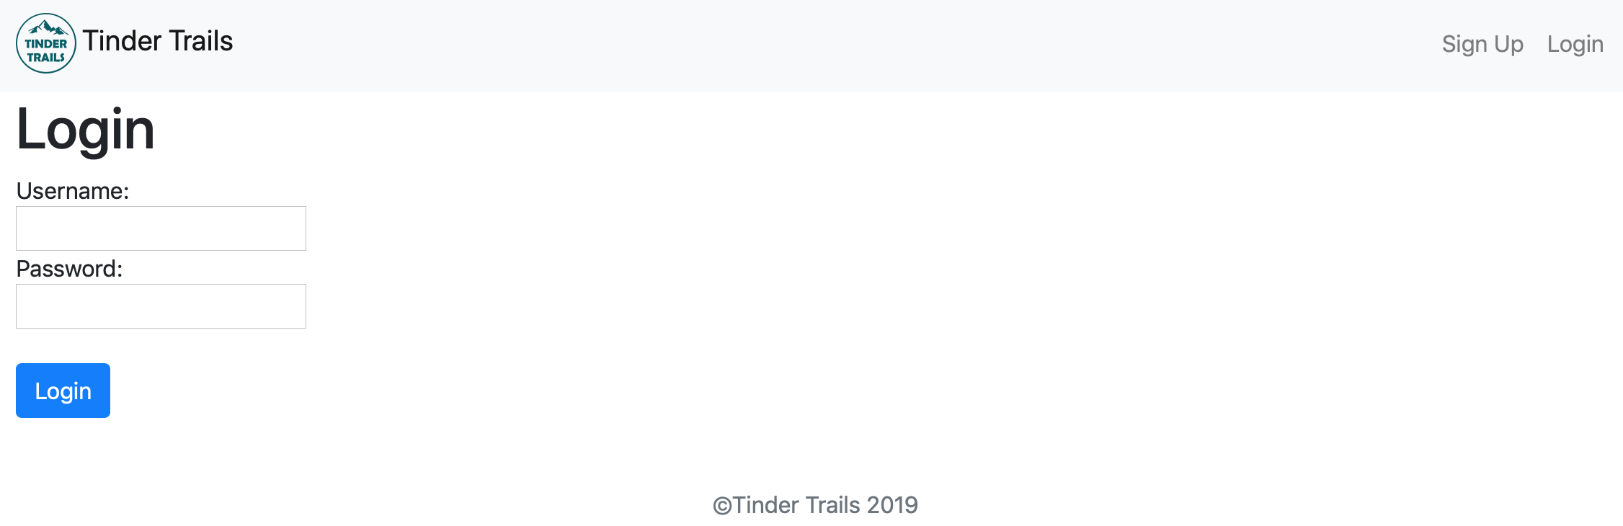
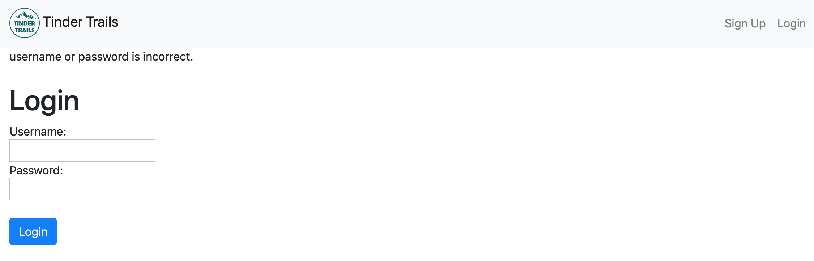
Django code walk through US_1a_Using Django to create sign up, login and log out US_1b_Send users back once they logged in or log out
Login
(tindertrails-project/accounts/templates/accounts/login.html)
(tindertrails-project/accounts/views.py)

Slide 14
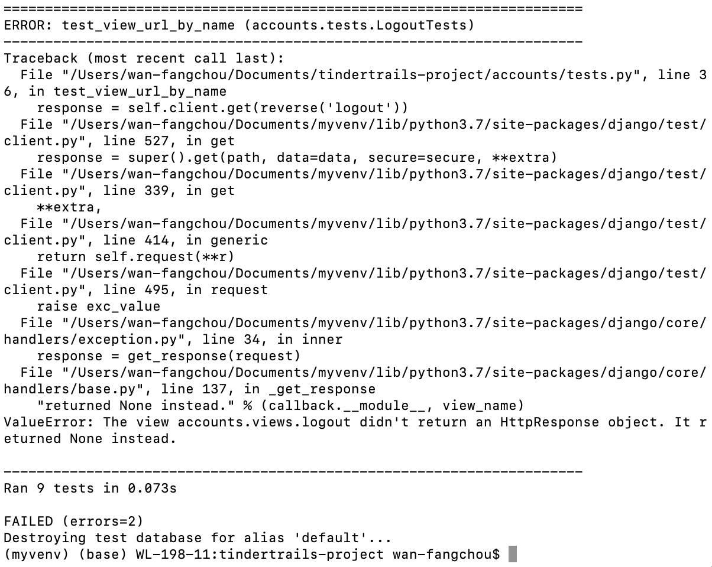
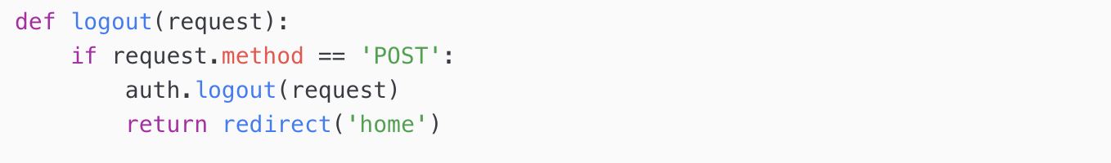
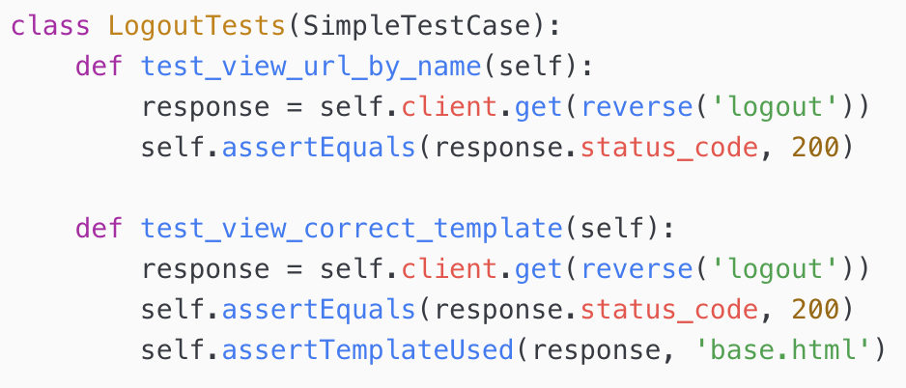
Django code walk through and test US_1a_Using Django to create sign up, login and log out US_1b_Send users back once they logged in or log out
Log out
(tindertrails-project/accounts/views.py)
Test

Slide 15
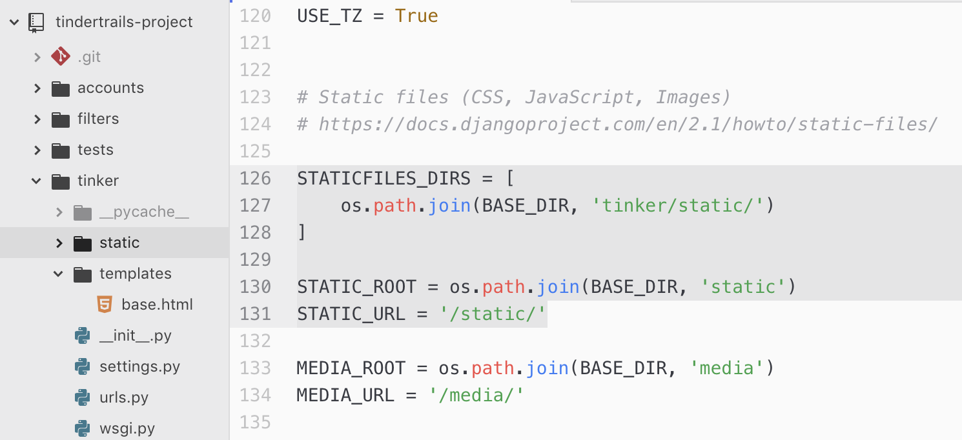
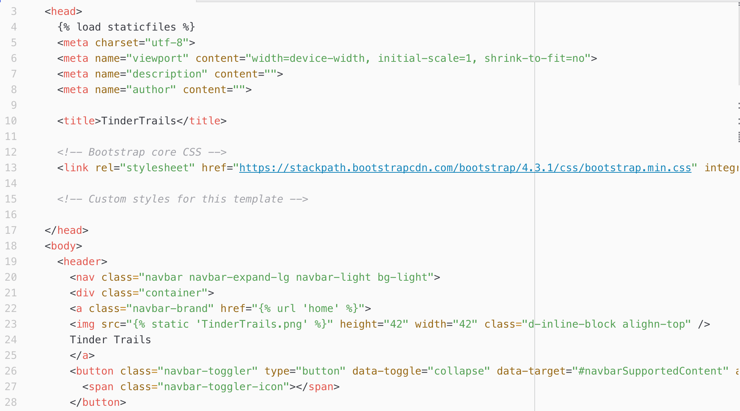
Django code walk through US_2g_The logo on the navigation bar could send users back to homepage
(tindertrails-project/tinker/settings.py)
(tindertrails-project/tinker/templates/base.html)

Slide 16
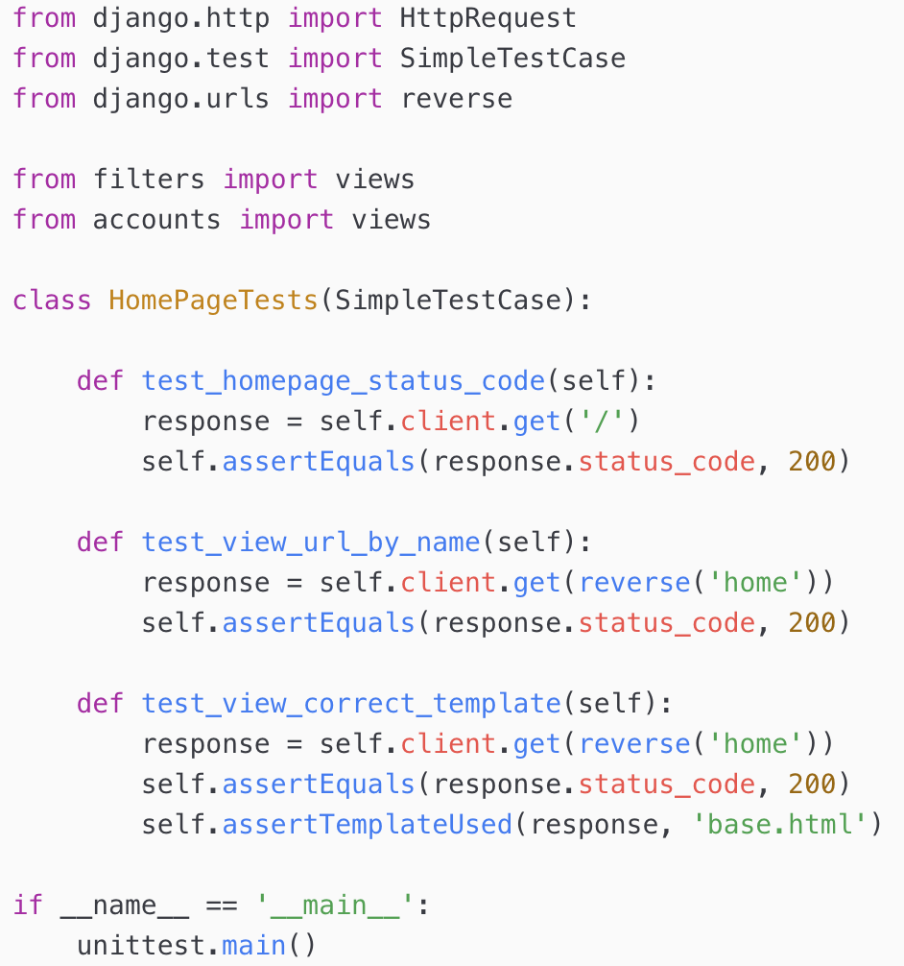
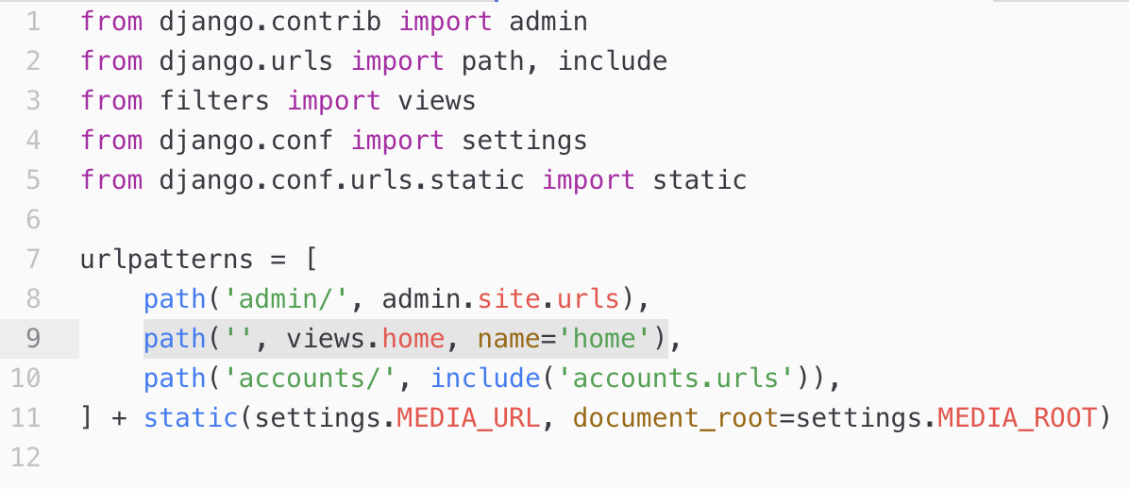
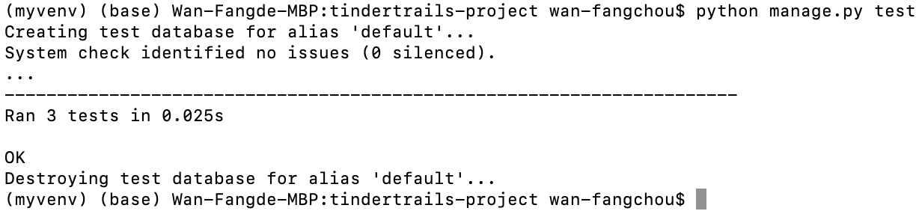
Django code walk through US_2a_On homepage, create find trails near me button and link to ArcGIS
Homepage url: http://165.22.132.51
(tindertrails-project/tinker/tests.py)
(tindertrails-project/tinker/urls.py)

Slide 17
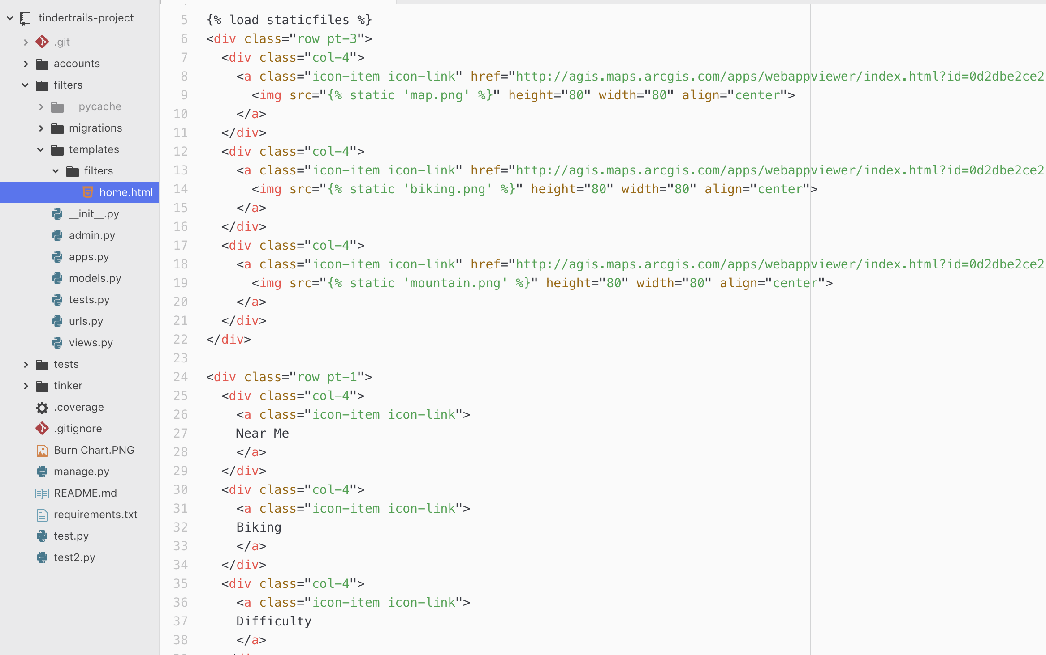
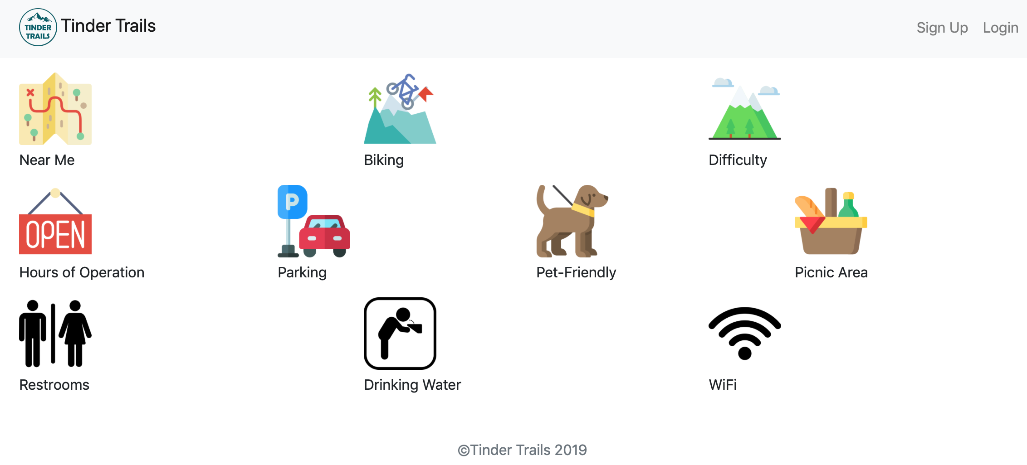
Django code walk through and test US_2a_On homepage, create find trails near me button and link to ArcGIS
Icons on homepage

Slide 18

Deploy Dejango app
http://165.22.132.51/

Slide 19
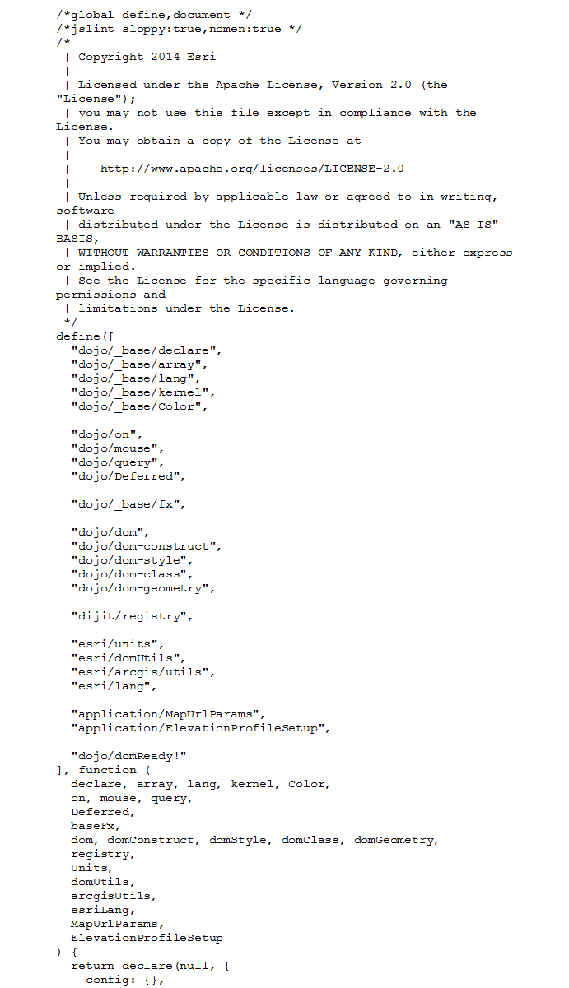
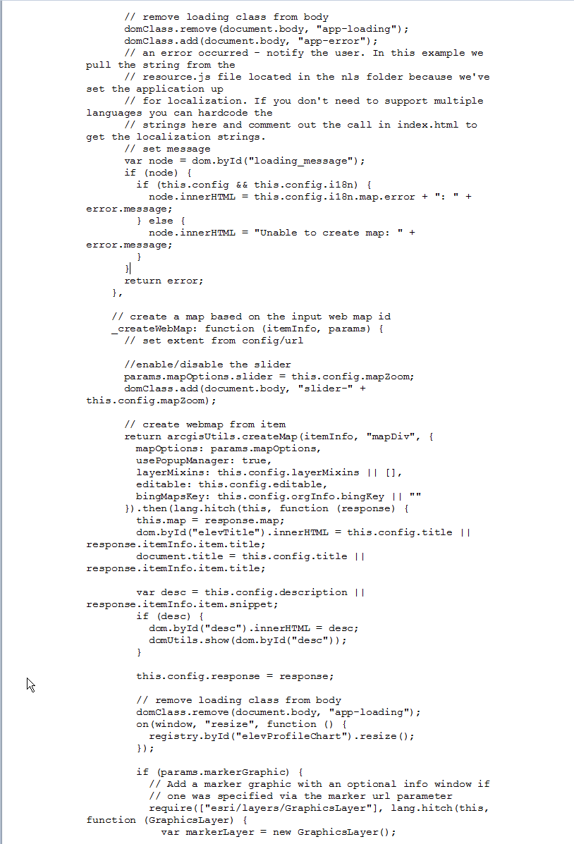
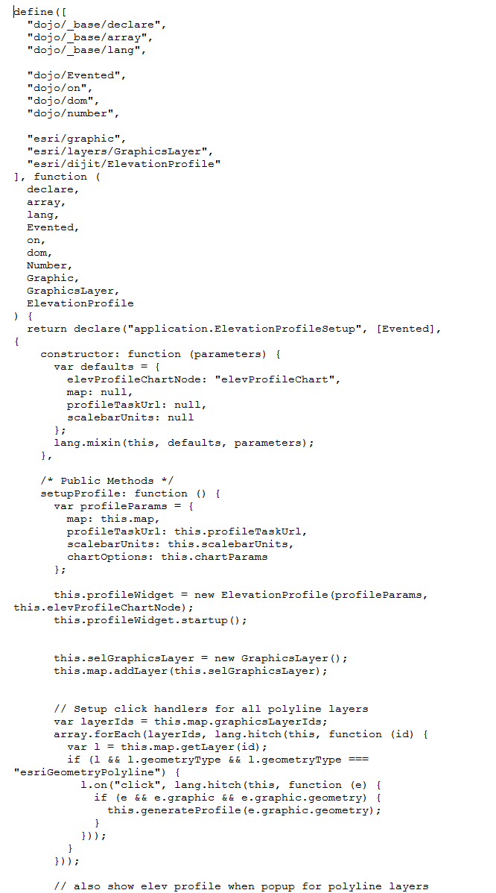
Hiking Trails
code
Walk through

Slide 20
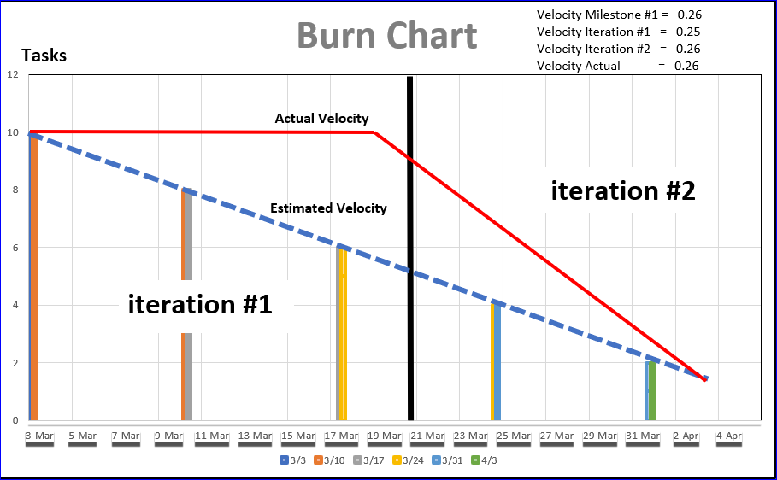

Slide 21
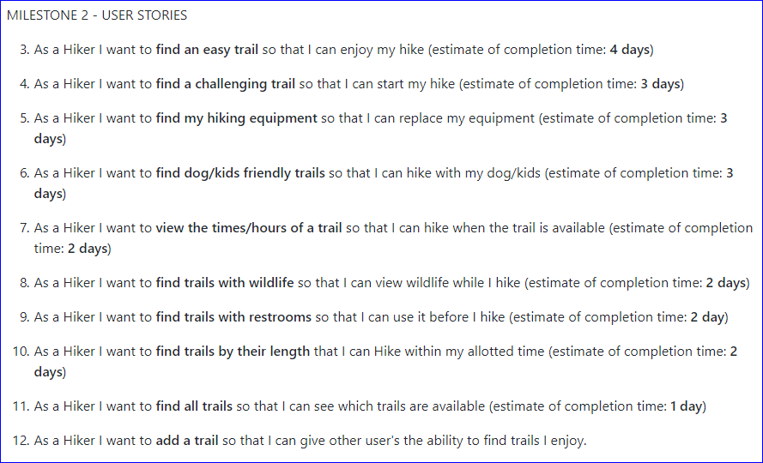
Milestone #2

Slide 22
Milestone #1 Reflections
Don’t commit to schedule when you’ve never used parts of the environment you’ll be using
Don’t be afraid to learn new things even if you thought that was impossible.

